Slide 1


An Introduction to DataSpaces
Part I – Overview
Instructors: Melissa Romanus, Tong Jin, Manish Parashar
Rutgers Discovery Informatics Institute (RDI2)
July 2015

Slide 2
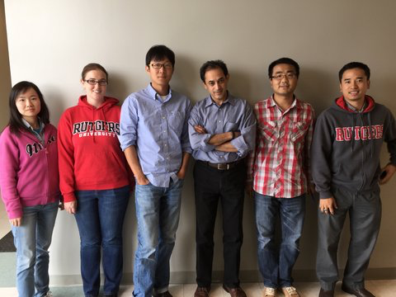
DataSpaces Team @ RU
Left to Right: Qian Sun, Melissa Romanus, Tong Jin, Manish Parashar, Fan Zhang, Hoang Bui, and (not shown) Mehmet Aktas

Slide 3
Outline
Data Grand Challenges
  Data challenges of simulation-based science
Rethinking the simulations -> insights pipeline
The DataSpaces Project
  Overview of DataSpaces architecture
  DataSpaces research activities
  DataSpaces Applications
DataSpaces – Hands-on
Conclusion

Slide 4
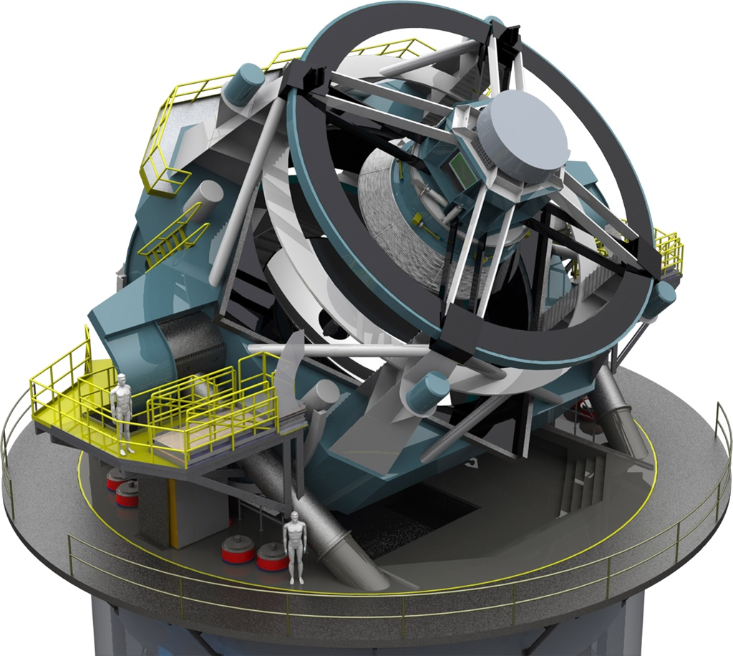

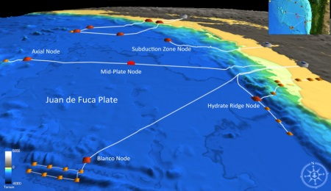


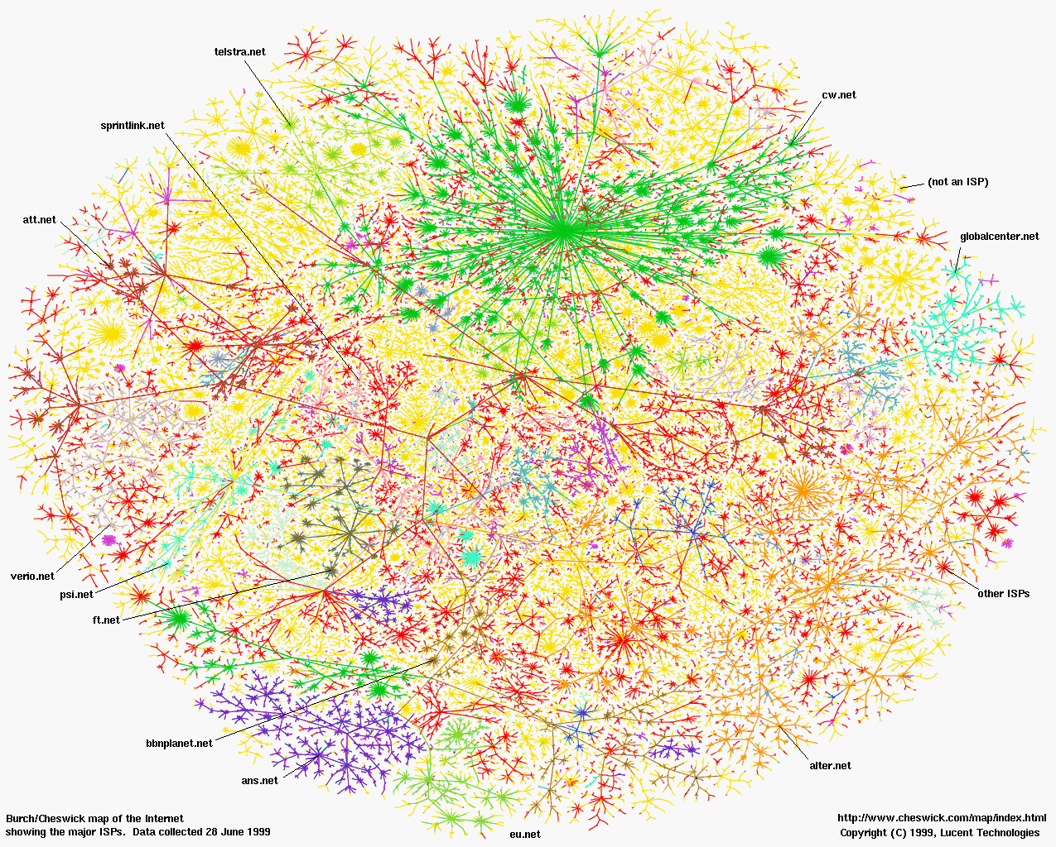

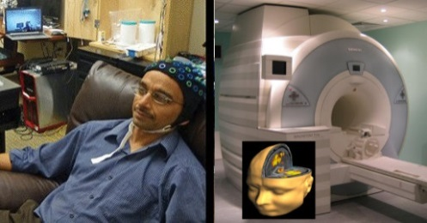
Data-driven Discovery in Science
Nearly every field of discovery is transitioning from “data poor” to “data rich”
Oceanography: OOI
Astronomy: LSST
Physics: LHC
Biology: Sequencing
Neuroscience: EEG, fMRI
Sociology: The Web
Economics: POS terminals
Credit: Ed Lazowska, Univ. of WA

Slide 5

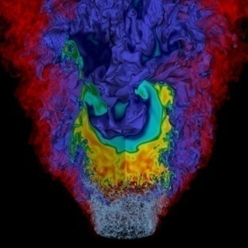
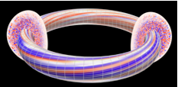
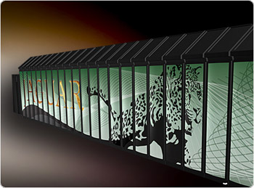
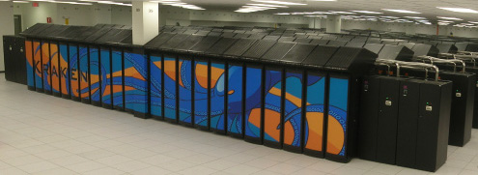
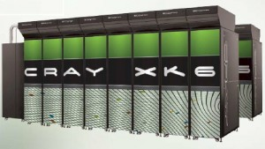

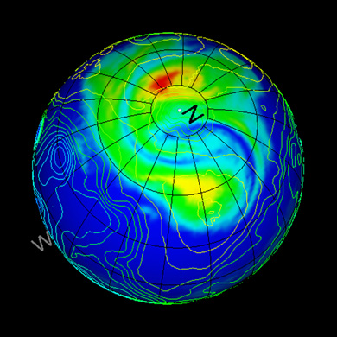



Scientific Discovery through Simulations
Scientific simulations running on high-end computing systems generate huge amounts of data!
  If a single core produces 2MB/minute on average, one of these machines could generate simulation data between ~170TB per hour -> ~700PB per day -> ~1.4EB per year
Successful scientific discovery depends on a comprehensive understanding of this enormous simulation data
How we enable the computation scientists to efficiently manage and explore extreme scale data: “find the needles in haystack” ??

Slide 6
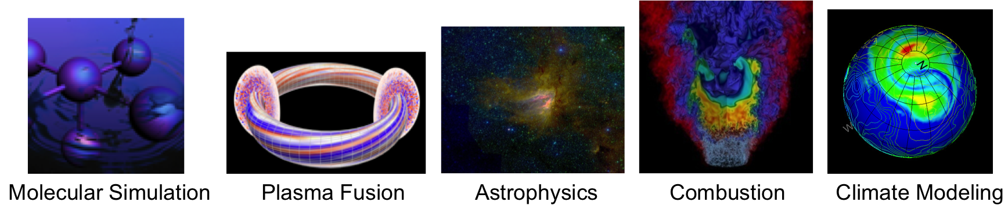
Scientific Discovery through Simulations
Complex workflows integrating coupled models, data management/processing, analytics
  Tight / loose coupling, data driven, ensembles
Advanced numerical methods (E.g., Adaptive Mesh Refinement)
Integrated (online) analytics, uncertainty quantification, …
Complex, heterogeneous components
Large data volumes and data rates
Data re-distribution (MxNxP), data transformations
Dynamic data exchange patterns
Strict performance/overhead constraints
Notes:
NWChem: computational chemistry at PNNL
CCSM: climate modeling at UCAR

Slide 7
Traditional Simulation -> Insight Pipelines Break Down
Storage Servers
Simulation
Raw Data
Analysis/Visualization Cluster
Simulation Machines
…
Figure. Traditional data analysis pipeline
Traditional simulation -> insight pipeline
  Run large-scale simulation workflows on large supercomputers
  Dump data to parallel disk systems
  Export data to archives
  Move data to users’ sites – usually selected subsets
  Perform data manipulations and analysis on mid-size clusters
  Collect experimental / observational data
  Move to analysis sites
  Perform comparison of experimental/observational to validate simulation data

Slide 8
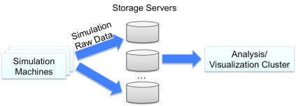
Challenges Faced by Traditional HPC Data Pipelines
Data analysis challenge
  Can current data mining, manipulation and visualization algorithms still work effectively on extreme scale machine?
I/O and storage challenge
  Increasing performance gap: disks are outpaced by computing speed
Data movement challenge
  Lots of data movement between simulation and analysis machines, between coupled multi-physics simulation components -> longer latencies
  Improving data locality is critical: do work where the data resides!
Figure. Traditional data analysis pipeline
Energy challenge
  Future extreme systems are designed to have low-power chips – however, much greater power consumption will be due to memory and data movement!
The costs of data movement are increasing and dominating!

Slide 9
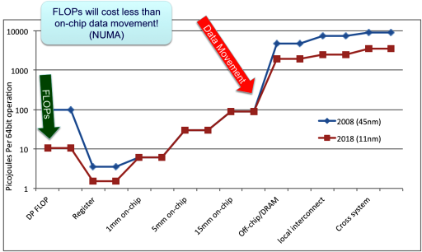
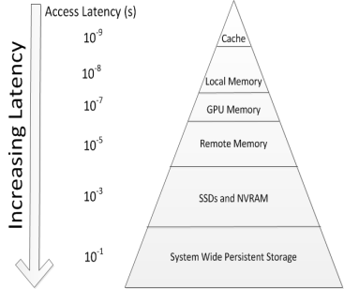
The Cost of Data Movement
Moving data between node memory and persistent storage is slow!
The energy cost of moving data is a significant concern
performance gap
From K. Yelick, “Software and Algorithms for Exascale: Ten Ways to Waste an Exascale Computer”

Slide 10
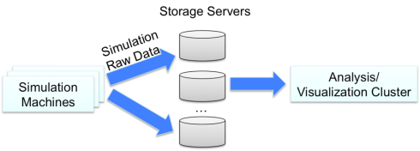
Challenges Faced by Traditional HPC Data Pipelines
Traditional data analysis pipeline
The costs of data movement (power and performance) are increasing and dominating!
We need to Rethink the Data Management Pipeline!
  Reduce data movement
  Move computation/analytics closer to the data
  Add value to simulation data along the IO path

Slide 11
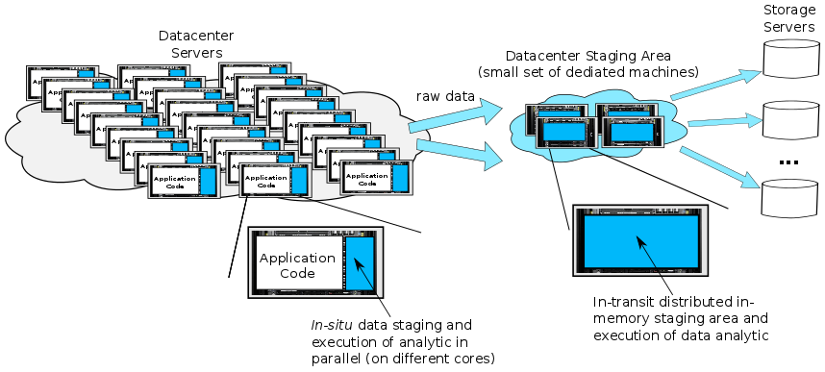
Rethinking the Data Management Pipeline – Data Staging + In-Situ & In-Transit Analysis
Exploit multi-levels in-memory Data Staging to:
  Decrease the gap between CPU and IO speeds
  Dynamically deploy and execute data analytical or pre-processing operations either in-situ or in-transit
  Improve IO write performance

Slide 12
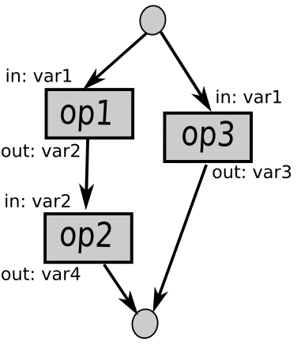
Rethinking the Data Management Pipeline – Hybrid Staging + In-Situ & In-Transit Execution
Issues/Challenges
  Programming abstractions/systems
  Mapping and scheduling
  Control and data flow
  Autonomic runtime
  Link with the external workflow
Systems
  Glean, Darshan, FlexPath, …..

Slide 13
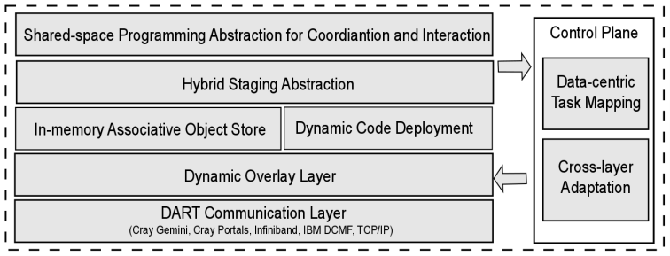

DataSpaces
In-situ/In-transit Data Management & Analytics
ADIOS/DataSpaces
dataspaces.org
Virtual shared-space programming abstraction
  Simple API for coordination, interaction and messaging
Distributed, associative, in-memory object store
  Online data indexing, flexible querying
Adaptive cross-layer runtime management
  Hybrid in-situ/in-transit execution
Efficient, high-throughput/low-latency asynchronous data transport

Slide 14
DataSpaces: A Scalable Shared Space Abstraction for Hybrid Data Staging [JCC12]
Shared-space programming abstraction over hybrid staging
  Simple API for coordination, interaction and messaging
  Provides a global-view programming abstraction
  Distributed, associative, in-deep-memory object store
  Online data indexing, flexible querying
Exposed as a persistent service
Autonomic cross-layer runtime management
High-throughput/low-latency asynchronous data transport
DataSpaces scalability on ORNL Titan

Slide 15
DataSpaces: A Scalable Shared Space Abstraction for Hybrid Data Staging [JCC12]
Shared-space programming abstraction over hybrid staging
  Simple API for coordination, interaction and messaging
  Provides a global-view programming abstraction
Exposed as a persistent service

Slide 16
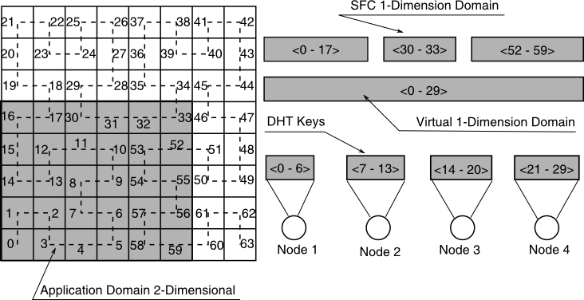
DataSpaces Abstraction: Indexing + DHT [HPDC10]
Dynamically constructed structured overlay using hybrid staging cores
Index constructed online using SFC mappings and applications attributes
  E.g., application domain, data, field values of interest, etc.
DHT used to maintain meta-data information
  E.g., geometric descriptors for the shared data, FastBit indices, etc.
Data objects load-balanced separately across staging cores

Slide 17
DataSpaces Abstraction: Indexing + Storage
Multi-dimensional information space for data objects
  For example, in many scientific applications, data object represents a sub-region of N-dimensional grid, mesh or tree – regions of interest can be described using bounding boxes
Figure. Examples of describing data objects using 3D information space for applications with 3D Cartesian data domain
This information space can be index to generate a domain specific index space
  E.g., using Space Filling Curve (SFC) indexing

Slide 18
DataSpaces: Indexing Hilbert SFC
f: N^{d} → N, recursive generation
0110
1001
11
01
10
1
0101
1000
0100
0111
1010
10
1011
0011
0010
1100
1101
01
00
11
0
1110
0000
0001
1111
00
0
1
00
01
10
11
Properties:
  Digital causality
  Locality preserving
  Clustering
Cluster: group of cells connected
by a segment of the curve

Slide 19
DataSpaces Abstraction: Indexing + DHT
Dynamically constructed structured overlay using hybrid staging cores
Index constructed online using SFC mappings and applications attributes
  E.g., application domain, data, field values of interest, etc.
DHT used to maintain meta-data information
  E.g., geometric descriptors for the shared data, FastBit indices, etc.
Data objects load-balanced separately across staging cores
The SFC maps the global domain to a set of intervals
  Intervals are non-contiguous and can lead to meta-data load imbalance
  Second mapping compacts the intervals into a contiguous virtual interval
  Split the contiguous interval equally to the DataSpaces nodes

Slide 20
DataSpaces: Publish Data
0
Data element
51
7
13
1
7
40
29
2
SFC index
The data element is published at node 13 (the successor of SFC index 7)
Data element is represented in a 2D info. space, as point (2, 1).
The point (2, 1) is mapped to index 7 using the Hilbert SFC.

Slide 21
DataSpaces: Query Data
Query 1:
Query 2:
(4-7,0-3)
(*, 4)
Query 1
0
51
13
4
3
47
0
40
33
4
7
Matching data
Query 2
Generate the clusters associated with the query
Query the nodes that store the clusters
Send the results to the requesting node

Slide 22
Query Engine Optimization
A query is typically mapped to thousands of clusters, many of them being stored at the same node
To send a message for each cluster is not feasible
Optimize the query processing such that
  Fewer clusters are generated
  The number of messages sent is minimized

Slide 23
Query Engine Optimization (cont’d)
Idea: use the recursive generation and digital causality property of SFC to optimize the query processing
SFCs can be generated recursively => clusters can be generated recursively => the process of cluster generation can be viewed as a tree
Optimization: embed the tree into the overlay, and prune tree nodes during the construction phase

Slide 24
Query Optimization
Query: (X = 30, Y = *) => Binary query (011110, *)
11
0101
0110
1001
1010
111
110
101
100
011
010
001
000
(011, *)
1
01
10
10
0100
0111
1000
1011
…
01
0011
0010
1101
1100
0
00
11
00
0000
0001
1110
1111
0
1
00
01
10
11
000 001 010 011 100 101 110 111
00
000000
0
111000
0
0001
01
000100
00,
01
001
100001
0001,
0010
0110,
0111
001001
011
000101,
000110
001001,
001010
011111
011010,
011011,
011100
0111
001111

Slide 25
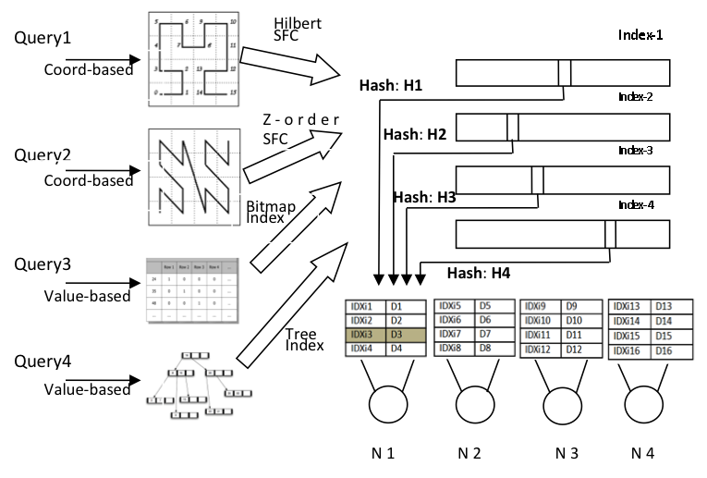
DataSpaces: Multiple Custom Indexes

Slide 26
DataSpaces/DIMES – Performance on Titan
Good strong scaling performance for DataSpaces put()/get()
    Number of workflow processes increases from 1K to 64K
    Array data size keeps unchanged at 4GB
    Achieve up to 1.16TB/s aggregate write throughput and up to 0.2TB/s aggregate read throughput
Figure. DataSpaces average put and get query time. X-axis shows the number of writer processes/reader processes in the testing workflow. Y-axis shows the query time.

Slide 27
DataSpaces/DIMES – Performance on Titan
Good strong scaling performance for DIMES put()/get()
    Number of workflow processes increases from 1K to 64K
    Array data size keeps unchanged at 4GB
    Achieve up to 125TB/s aggregate write throughput and 0.2TB/s aggregate read throughput
Figure. DIMES average put and get query time. X-axis shows the number of writer processes/reader processes in the testing workflow. Y-axis shows the query time.

Slide 28
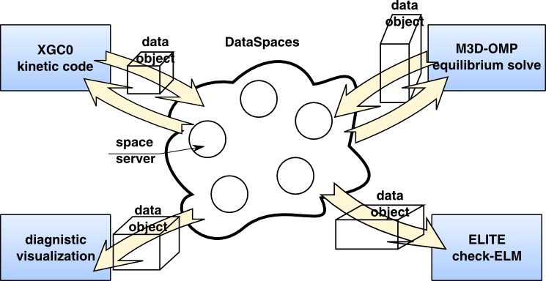
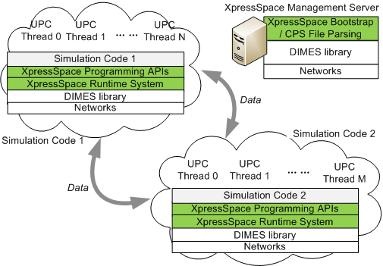
DataSpaces: Enabling Coupled Scientific Workflows at Extreme Scales
Multphysics Code Coupling at Extreme Scales [CCGrid10]
PGAS Extensions for Code Coupling [CCPE13]
Data-centric Mappings for In-Situ Workflows [IPDPS12]
Dynamic Code Deployment In-Staging [IPDPS11]

Slide 29
Coupling Patterns for Simulation Workflows
Tight coupling
  Coupled simulations/models run concurrently and exchange data frequently
  E.g., Coupled fusion simulations, multi-block subsurface modeling simulations
Loose coupling
  Coupling and data exchange are less frequent, and often asynchronous and possibly opportunistic
  E.g., Combustion simulations – DNS + LES coupling, material science simulations
Data-flow (data-driven) coupling
  Workflows expressed as dataflow based DAG where data produced by a simulation flows through one or more data processing pipelines
  E.g., End-to-end simulations workflows with data analytics
Ensemble workflows
  Multiple fan-out stages composed of large numbers of loosely coupled or independent simulations
  E.g., Uncertainty quantification, history matching, data assimilation

Slide 30
Overview of Research Work @ RU
Programming abstractions / system
  DataSpaces: Interaction, coordination and messaging abstractions for coupled scientific workflow [HPDC10, CCGrid10, HiPC12, JCC12]
  XpressSpaces: PGAS extensions for coupling using DataSpaces [CCGrid11, CCPE13]
  ActiveSpaces: Dynamic code deployment for in-staging data processing [IPDPS11]
Runtime mechanisms
  Data-centric Task Mapping: Reduce data movement and increase intra-node data sharing [IPDPS12, DISC12]
  In-situ & In-transit Data Analytics: Simulation-time analysis of large volume data by combining in-situ and in-transit execution [SC12, DISC12]
  Cross-layer Adaptation: Adaptive cross-layer approach for dynamic data management in large scale simulation-analysis workflow [SC13]
  Value-based Data Indexing and Querying : Use FastBit to build in-situ, in-memory value-based indexing and query support in the staging area
  Power/performance Tradeoffs: Characterizing power/performance tradeoffs for data-intensive simulations workflows [SC13]
  Data Staging over Deep Memory Hierarchy: Build distributed associative object store over hierarchical memory storage, e.g. DRAM/NVRAM/SSD [HiPC 13]
High-throughput/low-latency asynchronous data transport
  DART: Network independent transport library for high speed asynchronous data extraction and transfer [HPDC08]

Slide 31
Research Activities
Programming abstraction
  Enable building coupled scientific workflow consisting of interacting applications, and expressing the data sharing and coordination (HPDC’10, CC‘12)
High-performance data staging and transport framework
  Enable distributed in-memory staging of scientific simulation data, as well as high-throughput/low-latency data transport and redistribution (HPDC’08, CCPE‘10)
In-situ/In-transit data analytics framework
  Enable online data analytics for large-scale scientific simulations (SC’12)
Adaptive runtime management
  Optimize the performance of simulation-analysis workflow through adaptive data and analysis placement, data-centric task mapping, and utilization of deep memory hierarchy. (IPDPS’11, SC’13, CLUSTER’14)
Scalable online data indexing and querying
  Enable query-driven data analytics to extract insights from the large volume of scientific simulation data (BDAC’14)
Data Staging as a Service
  Persistent staging servers run as a service and allow coupled applications join, progress and leave the shared space independently

Slide 32
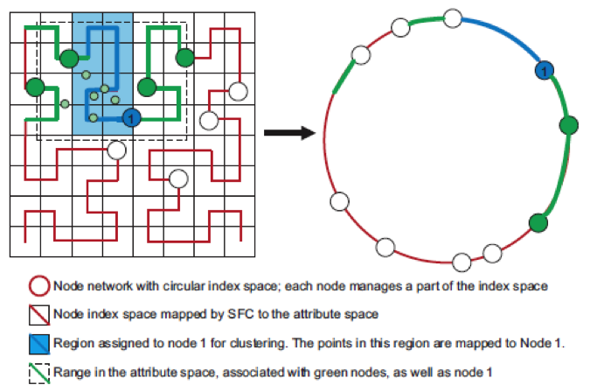
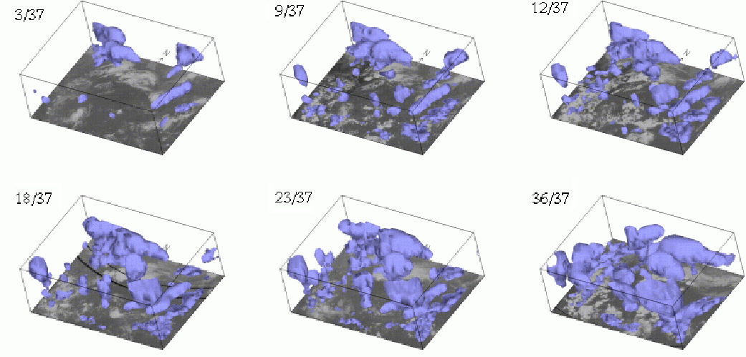
In-Situ Feature Extraction and Tracking using Decentralized Online Clustering (DISC’12)
DOC workers executed in-situ on simulation machines
DOC Overlay
Simulation Compute Nodes
Processor core runs simulation
Processor core runs DOC worker
Benefits of runtime feature extraction and tracking
(1) Scientists can follow the events of interest (or data of interest)
(2) Scientists can do real-time monitoring of the running simulations
One compute node

Slide 33
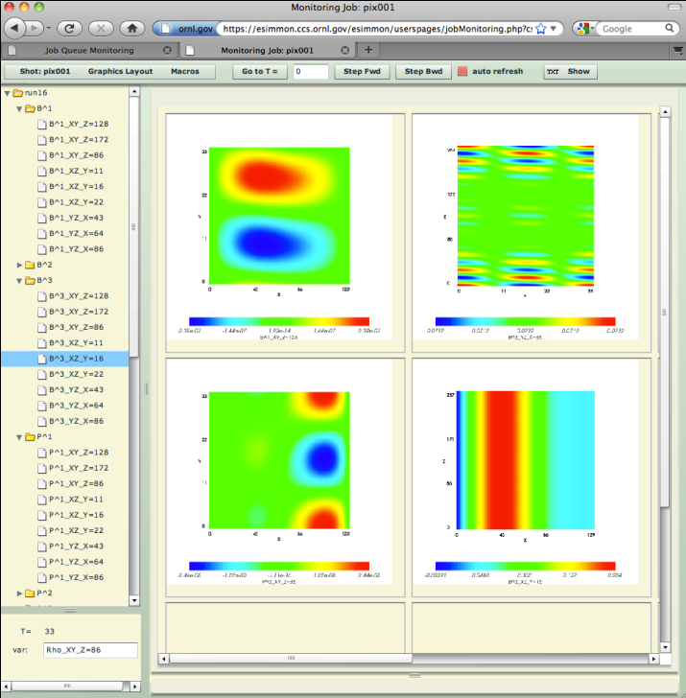
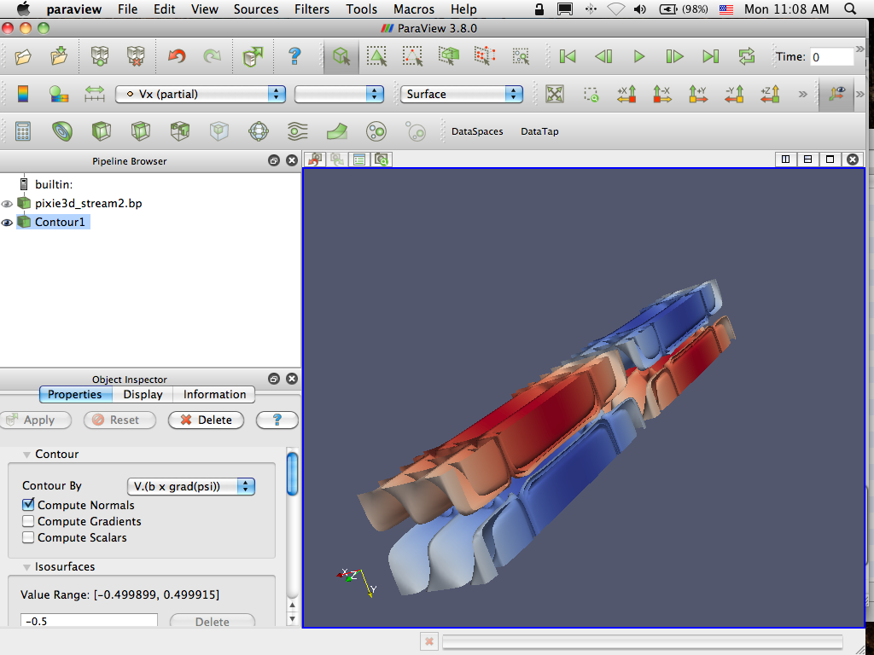


In-situ viz. and monitoring with staging (SC’12)
Pixie3D
1024 cores
Pixplot
8 cores
record.bp
Pixmon
1 core
(login node)
record.bp
record.bp
pixie3d.bp
pixie3d.bp
pixie3d.bp
ParaView Server
4 cores
DataSpaces

Slide 34
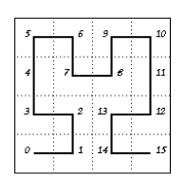
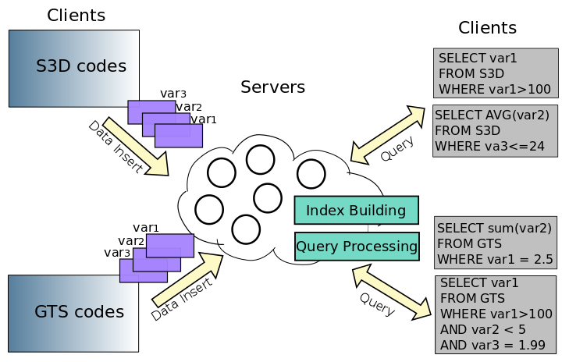
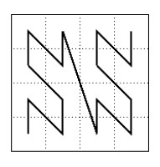
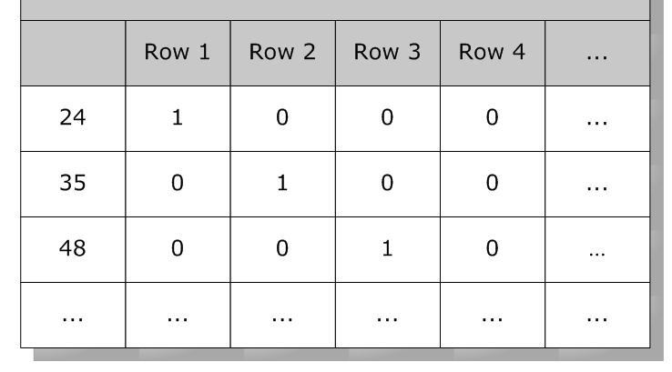
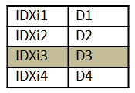
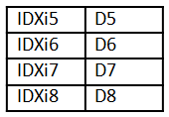
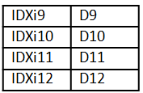
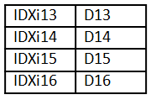
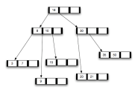
Scalable Online Data Indexing and Querying (BDAC’14, CCPE’15)
Enable query-driven data analytics to extract insights from the large volume of scientific simulation data
Query1
Hilbert
SFC
Index-1
Coord-based
Hash: H1
Index-2
Z-order SFC
Query2
Hash: H2
Index-3
Coord-based
Bitmap
Index
Hash: H3
Index-4
Query3
Hash: H4
Value-based
Query4
Tree
Index
Value-based
N 1
N 2
N 3
N 4
Figure. Value-based online index and query framework using FastBit
Figure. Conceptual view of the programmable online indexing & querying using multiple index

Slide 35
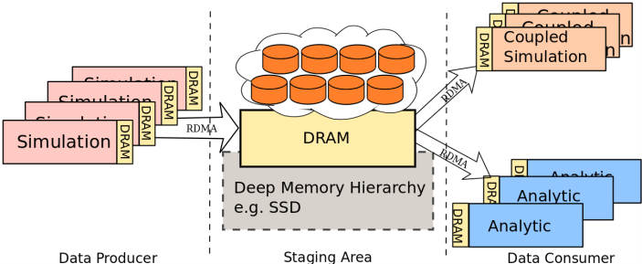
Multi-tiered Data Staging with Autonomic
Data Placement Adaptation – Overview (IPDPS’15)
Fig. Conceptual framework for realizing multi-tiered staging for coupled data-intensive simulation workflows.
A multi-tiered data staging approach that uses both DRAM and SSD to support data-intensive simulation workflows with large data coupling requirements.
Efficient application-aware data placement mechanism that leverages user provided data access pattern information

Slide 36
Data Staging-as-a-Service
Persistent staging servers run as a service and allow coupled applications join, progress and leave the shared space independently
  Example: FEM-AMR workflow using DataSpaces-as-a-service
    Allow multiple AMR codes to be dynamically plugged in and read Grid/GridField data as FEM progresses
    Support in-memory data coupling between FEM and AMR code
Grid
GridField
DataSpaces
Grid
GridField
FEM
AMR
pGrid
pGridField
pGrid
pGridField
FEM: model uniform 3D mesh of near-realistic engineering problems such as heat-transfer, fluid flow and phase transformation
  AMR: localize areas of interest where the physics is important to allow truly realistic simulations

Slide 37
Wide-area Staging (Demo at SC’14)
Wide-area shared staging abstraction achieved by interconnecting multiple staging instances
  Leverages SDN for provisioning; Workflow/Grid technologies
Data placement optimized based on demand, availability, locality, etc.
Dataspaces WA
App
App
Control
Node
ADIOS/
Dataspaces
TCP/IP
ADIOS/
Dataspaces
get()/sub()
put()/pub()
RDMA, Gridftp
Data Tx/Rx
Node
Notes:
Can we make the fonts in the figure bigger?

Slide 38




Network/System Supported by DataSpaces
Cray XE6/XK7: Titan (ORNL), Hopper (NERSC)
InfiniBand: Sith (ORNL), Stampede (XSEDE)
IBM BlueGene P/BlueGene Q: Intrepid (Rutgers), Mira (ANL)
Coming soon: Cray XC30 (EOS at ORNL, Edison at NERSC)
Sith at Oak Ridge National Lab
Titan at Oak Ridge National Lab
Mira at Argonne National Lab
IBM Summit Coming 2018
Notes:
Cray XK
IB: Sith, Stampede,
IBM BGP BGQ
TCP

Slide 39
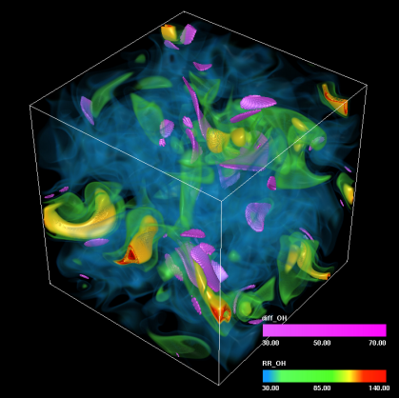
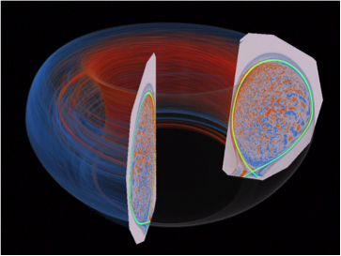
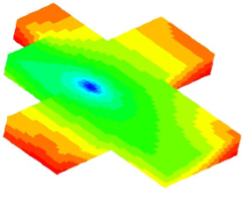
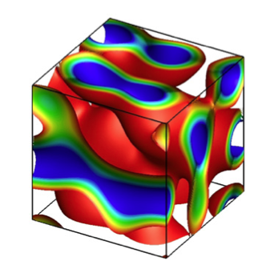
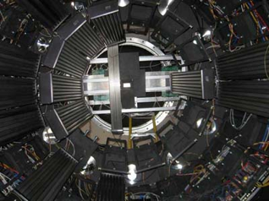
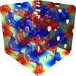
Combustion: S3D uses chemical model to simulate combustion process in order to understand the ignition characteristic of bio-fuels for automotive usage.
Publication: SC 2012.
Fusion: EPSi simulation workflow provides insight into edge plasma physics in magnetic fusion devices by simulating movement of millions particles.
Publication: CCGrid 2010, Cluster 2014
Subsurface modeling: IPARS uses multi-physics, multi-model formulations and coupled multi-block grids to support oil reservoir simulation of realistic, high-resolution reservoir studies with a million or more grids.
Publication: CCGrid 2011
Computational mechanics: FEM coupled with AMR is often used to solve heat transfer or fluid dynamic problems. AMR only performs refinements on important region of the mesh. (work in progress)
Material Science: SNS workflow enables integration of data, analysis, and modeling tools for materials science experiments to accelerate scientific discoveries which requires beam lines data query capability. (work in progress)
Material Science: QMCPack utilizes quantum Monte Carlo (QMC) studies in heterogeneous catalysis of transition metal nanoparticles, phase transitions, properties of materials under pressure, and strongly correlated materials. (work in progress)

Slide 40





DataSpaces Collaborators
ADIOS – ORNL: Scott Klasky, Norbert Podhorszki, Hassan Abbasi, Gary Liu
EPSI Project: Jong Choi, Robert Hager, Salomon Janhunen
Emory College: George Teodoro
LBNL: John Wu
Sandia NL: Hemanth Kolla, Jackie Chen
U of Nebraska-Lincoln: Hongfeng Yu
Stony Brook: Tahsin Kurc
Iowa Sate: Baskar Ganapathysubramanian, Rorbert Dyja
….and many more

Slide 41
In this presentation
Integrated In-situ, in-transit data analysis pipeline
Apply cross layer adaptation to reduce data movement in HPC application
Scalable in-memory data indexing and querying for scientific simulation workflows
Study power/performance tradeoffs in data analytics pipeline
DataSpaces as-a-service model for persistent data staging

Slide 42
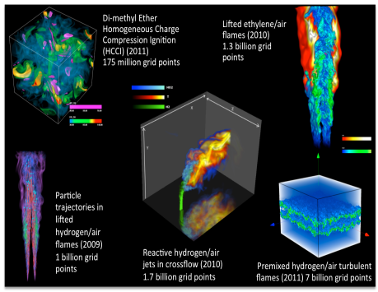
S3D Simulation Data Sets
S3D: First-principles direct numerical simulation
HCCI
  Understanding the ignition characteristics of typical bio-fuels for automotive applications
  175 million grid points
Lifted
  Mechanism for ethylene-air combustion
  1.3 billion grid points
Recent data sets generated by S3D, developed at the Combustion Research Facility, Sandia National Laboratories
Notes:
In this paper we con- sider two different S3D simulations. The first is a turbulent autoignitive mixture of di-methyl-ether and air under typical homogeneous charge compression ignition (HCCI) conditions [4]. This simulation is aimed at understanding the ignition characteristics of typical bio-fuels for automotive applications and has a domain size of over 175 million grid points. The second simulation describes a lifted ethylene jet flame [73], involved in a reduced chemical mechanism for ethylene-air combustion, with a domain size of 1.3 billion grid points.

Slide 43

Integrating In-situ and In-transit Analytics [SC’12]
S3D: First-principles direct numerical simulation
Simulation resolves features on the order of 10 simulation time steps
Currently on the order of every 400th time step can be written to disk
Temporal fidelity is compromised when analysis is done as a post-process
Recent data sets generated by S3D, developed at the Combustion Research Facility, Sandia National Laboratories
Notes:
the ExaCT center for exascale simulation of Combustion in turbulence is
one of the three DOE Office of Science funded centers focused on exascale co-design
One of the turbulent combustion codes we work with is S3D, developed at SNL by Jacqueline Chen and her research group
Direct numerical simulations resolve all spatial and temporal scales associated with turbulence
and for production runs the time steps taken to advance the solution are smaller than the smallest time scales.
The highest frequency features in the data are resolved on the order of 10 simulation time steps,
however in order to keep I/O costs at a reasonable overhead, on the order of every 400th time step is written to disk.
So, when we perform analysis as a post-process, we are already losing the ability to track the simulation’s highest frequency events.

Slide 44
Integrating In-situ and In-transit Analytics – Motivation
S3D: First-principles direct numerical simulation
Simulation resolves features on the order of 10 simulation time steps
Currently on the order of every 400th time step can be written to disk
Temporal fidelity is compromised when analysis is done as a post-process
There is a widening gap between compute power & available I/O rates
It will be difficult to save data for post processing at a high enough temporal frequency
We need new concurrent workflow designs
Recent data sets generated by S3D, developed at the Combustion Research Facility, Sandia National Laboratories
Notes:
the ExaCT center for exascale simulation of Combustion in turbulence is
one of the three DOE Office of Science funded centers focused on exascale co-design
One of the turbulent combustion codes we work with is S3D, developed at SNL by Jacqueline Chen and her research group
Direct numerical simulations resolve all spatial and temporal scales associated with turbulence
and for production runs the time steps taken to advance the solution are smaller than the smallest time scales.
The highest frequency features in the data are resolved on the order of 10 simulation time steps,
however in order to keep I/O costs at a reasonable overhead, on the order of every 400th time step is written to disk.
So, when we perform analysis as a post-process, we are already losing the ability to track the simulation’s highest frequency events.

Slide 45
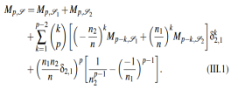
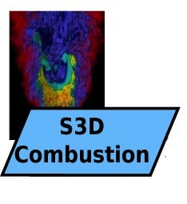
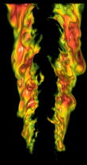
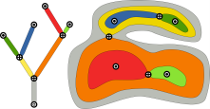
Integrating In-situ and In-transit Analytics – Design
Couple concurrent data analysis with simulation
Statistics
Volume Rendering
Identify features of interest
Topology
*J. C. Bennett et al., “Combining In-Situ and In-Transit Processing to Enable Extreme-Scale Scientific Analysis”, SC’12, Salt Lake City, Utah, November, 2012.
Notes:
Topological analysis technique for computing merge-trees.This algorithm is for analysis purposes to identify features of interest in the data based on the level-set behavior of a simulation variable

Slide 46
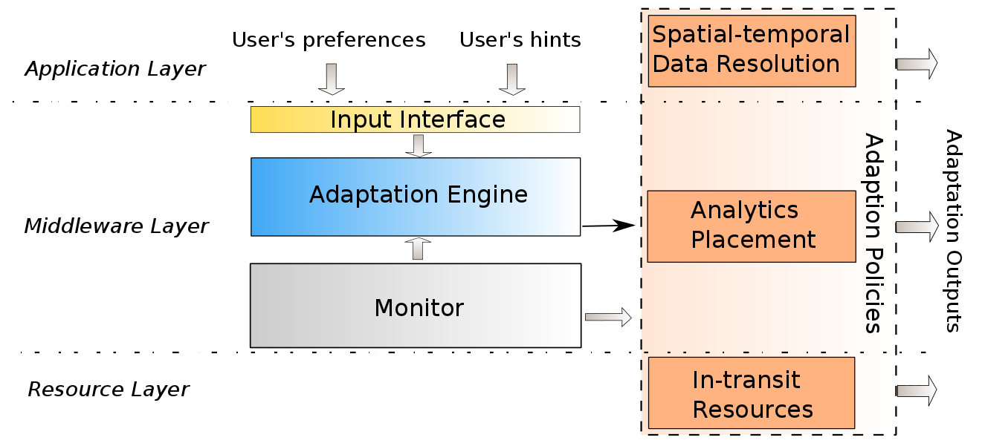
In-situ/In-transit Data Analytics
Online data analytics for large-scale simulation workflows
  Combine both in-situ and in-transit placement to reduce impact on simulation, reduce network data movement, reduce total execution time
  Adaptive runtime management: Optimize the performance of simulation-analysis workflow through adaptive data and analysis placement, data-centric task mapping
Figure. Overview of the in-situ/in-transit data analysis framework
Figure. System architecture for cross-layer runtime adaptation

Slide 47
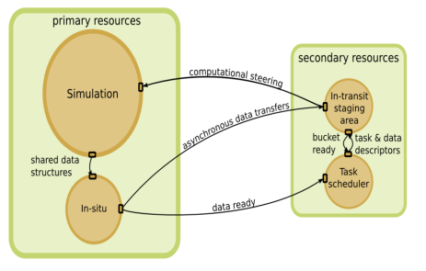
Integrating In-situ and In-transit Analytics – Design
Combine both in-situ and in-transit placement to
  Reduce impact on simulation
  Reduce network data movement
  Reduce total execution time
Primary resources execute the main simulation and in situ computations
Secondary resources provide a staging area whose cores act as containers for in transit computations

Slide 48


Integrating In-Situ and In-Transit Analytics (SC’12)
Primary resources execute the main simulation and in situ computations
Secondary resources provide a staging area whose cores act as buckets for in transit computations
4896 cores total (4480 simulation/in situ; 256 in transit; 160 task scheduling/data movement)
Simulation size: 1600x1372x430
All measurements are per simulation time step
Notes:
This plot demonstrates results
Various in-situ/in-transit decompositions were created for volume rendering, topological feature extraction and computation of descriptive statistics – 3 algorithms with different levels of inherent data parallelism.
Details regarding plot:
The grid domain size was 1600 × 1372 × 430 and the results shown here were for a core count of 4896
Among the three analytics tasks, we compared visualization and descriptive statistics under two modes, an entirely in-situ mode and an in-situ + in-transit mode, while the topological analysis was tested in only the in-situ + in-transit mode.
We can clearly see that the in-situ visualization and the in- situ descriptive statistics only account for a small fraction of the total simulation time (4.33 % and 9.73 % respectively)
We also see that while the overall time required to compute in a hybrid in-situ + in-transit manner may be greater than for a purely insitu analyses in some settings, the hybrid approach returns control to the simulation more quickly than in the corresponding purely in-situ analysis.
This is a huge win for analyses that are conventionally difficult to parallelize (such as topological analysis): a set of data parallel operations greatly reduces the amount of data to be transferred to the secondary resources, while still returning control to the simulation in a timely manner.
While the approach shows great promise, many of the research challenges from the previous slide still remain!

Slide 49

Integrating In-Situ and In-Transit Analytics (SC’12)
Primary resources execute the main simulation and in situ computations
Secondary resources provide a staging area whose cores act as containers for in transit computations
4896 cores total (4480 simulation/in situ; 256 in transit; 160 task scheduling/data movement)
Simulation size: 1600x1372x430
All measurements are per simulation time step
Notes:
This plot demonstrates results
Various in-situ/in-transit decompositions were created for volume rendering, topological feature extraction and computation of descriptive statistics – 3 algorithms with different levels of inherent data parallelism.
Details regarding plot:
The grid domain size was 1600 × 1372 × 430 and the results shown here were for a core count of 4896
Among the three analytics tasks, we compared visualization and descriptive statistics under two modes, an entirely in-situ mode and an in-situ + in-transit mode, while the topological analysis was tested in only the in-situ + in-transit mode.
We can clearly see that the in-situ visualization and the in- situ descriptive statistics only account for a small fraction of the total simulation time (4.33 % and 9.73 % respectively)
We also see that while the overall time required to compute in a hybrid in-situ + in-transit manner may be greater than for a purely insitu analyses in some settings, the hybrid approach returns control to the simulation more quickly than in the corresponding purely in-situ analysis.
This is a huge win for analyses that are conventionally difficult to parallelize (such as topological analysis): a set of data parallel operations greatly reduces the amount of data to be transferred to the secondary resources, while still returning control to the simulation in a timely manner.
While the approach shows great promise, many of the research challenges from the previous slide still remain!

Slide 50

Simulation case study with S3D: Experimental set up
Volume size | 1600x1372x430
# of variables | 14
Variable size (bytes) | 8
Data size (GB) | 98.5
I/O read time (sec/time step) | 6.56
I/O write time (sec./time step) | 3.28
Simulation run time (sec./time step) | 16.85
Analysis frequency | Set by scientist
Number of cores | 4896
# simulation/in-situ cores | 16x28x10=4480
# task scheduler cores | 160
# in-transit cores | 256
Jaguar, Cray XK6
18,688 nodes
Gemini interconnect
16-core AMD 6200 series Opteron processor
600 TB system memory
Notes:
We performed our case study on Jaguar the Cray XK6 with design specs shown here on the slide
The table shows the experimental set up for the timing results I’ll show on the next few slides
The simulation volume size was 1600 x 1372 x 430 with 14 double precision variables, resulting in a data size of 98.5 GB
Run times for simulation, i/o read and write are shown for each simulation time step in seconds.
Our framework allows the analysis frequency to be controlled by the scientist, but we staggered the analysis, and show timing results for a couple of different frequencies
The number of simulation and in-situ cores used was 4480, the number of in-transit cores were 256, and the number of task-scheduler cores were 160

Slide 51
Simulation case study with S3D: Timing results for 4896 cores and analysis every simulation time step
Notes:
These are timing results for the performing the analysis every timestep
statistics- which is a largely data-parallel operation, the overhead of going to a hybrid technique was not worth it, in fact the in-situ run time increased in the hybrid scenario
For visualization, a fully in-situ algorithm is very efficient.
However, when we move to a hybrid approach, although the total run-time increases, the impact to the simulation in terms of performance costs becomes almost negligible, even when done at each simulation time-step.
Our hybrid implementation of the topology algorithm can efficiently compute local subtrees.
The intermediate of ~ 87 MB, is transferred asynchronously and aggregated in-transit to compute the global tree.
Allowing the scientists to deploy algorithms that are not inherently data-parallel concurrently, making it possible to capture and track highly intermittent, transient phenomena.

Slide 52
Simulation case study with S3D: Timing results for 4896 cores and analysis every simulation time step
10.0%
10.1%
4.3%
.04%
16.1%
Notes:
We can actually look at the analysis in terms of the percentage of the total simulation time

Slide 53
Simulation case study with S3D: Timing results for 4896 cores and analysis every 10th simulation time step
1.0%
1.0%
.43%
.004%
1.61%
Notes:
We can see that the impact to the simulation decreases as we increase the number of simulation time steps performed between analyses.
Here you see a plot for analysis performed once every 10th timestep

Slide 54
Simulation case study with S3D: Timing results for 4896 cores and analysis every 100th simulation time step
.1%
.1%
.04%
.004%
.16%
Notes:
And here analysis being performed every 100th simulation timestep
The analysis frequency for different types of simulations as well as different analyses will be different and
And will depend on the type of simulation and analysis being performed.

Slide 55
Related Publications
J. C. Bennett et al., “Combining In-Situ and In-Transit Processing to Enable Extreme-Scale Scientific Analysis”, SC’12, Salt Lake City, Utah, November, 2012.

Slide 56

Autonomic Cross-Layer Adaptations for Dynamic Data Management (SC13)
Coupled simulation-analytics workflow based on dynamic formulations such as Adaptive Mesh Refinement (AMR) running at extreme scales present new challenges for in-situ/in-transit data management
  Large and dynamically changing volume of data
  Dynamic imbalanced data distribution
  Heterogeneous resource (memory, CPU, etc.) requirements
Notes:
Coupled workflow. Simulation-analytics
Dynamic behavior in such simulation workflow.
Figure: left: simulation-analytics workflow; right: peak memory distribution in chombo-based AMR code.

Slide 57

Autonomic Adaptation for Dynamic Online Data Management - Motivation
Coupled simulation-analytics workflow running at extreme scales present new challenges for in-situ/in-transit data management
  Large and dynamically changing volume and distribution of data
  Heterogeneous resource (memory, CPU, etc.) requirements
  Energy and/or resilient requirement

Slide 58

Autonomic Cross-Layer Adaptations – Overall Architecture
Autonomic cross-layer adaptations that can respond at runtime to the dynamic data management and data processing requirements
Application layer: Adaptive spatial-temporal data resolution
Middleware layer: Dynamic in-situ/in-transit placement and scheduling
Resource layer: Dynamic allocation of in-transit resources
Coordinated approaches: Combine mechanisms towards a specific objective
Notes:
The approach and related adaptations.
The conceptual architecture.

Slide 59
Autonomic Cross-Layer Adaptations – Results
Application Workflow
  Simulation: Chombo-based AMR
  Analysis/Visualization: marching cubes algorithms
Platforms
  ALCF Intrepid IBM BlueGene/P
  OLCF Titan Cray XK7
Performance Metrics
  Overall execution time
  Size of data movement
  Utilization efficiency of the staging resource
Summary of Results (16K cores)
  Reduced overall data movement between the AMR-based simulation and in-situ analytics by up to 45%
  Overhead of the end-to-end execution time is decreased by up to 75%
  Utilization efficiency of in-transit staging cores is increased from 54.57% to 87.11%

Slide 60


Autonomic Cross-Layer Adaptations – Results
- Adaptation on Data Resolution
Application layer adaptation of the spatial resolution of data using user-defined down-sampling based on runtime memory availability.
Application layer adaptation of the spatial resolution of the data using entropy based data down-sampling.
(Top: full-resolution; Bottom: adaptive resolution)
Notes:
Application layer adaptation result

Slide 61

Autonomic Cross-Layer Adaptations – Results
- Adaptation on Analytic Placement
a. Data transfer with/without middleware adaptation at different scales
Adapt the placement on-the-fly, utilizing the flexibility of in-situ (less data movement).
b. Comparison of cumulative end-to-end execution time between static placement (in-situ/in-transit) and adaptive placement. End-to-end overhead includes data processing time, data transfer time, and other system overhead.
Notes:
Result 1: Utilize the flexibility of in-transit and in-situ, to achieve less data movement and minimizing overall time-to-solution

Slide 62

Autonomic Cross-Layer Adaptations – Results
- Adaptation on Analytic Placement
Amount of data transfer using static analytic placement, adaptive analytic placement and combined adaption (adaptive data resolution + adaptive placement). Left: comparison between static placement and adaptive placement; right: comparison between adaptive placement and combined adaptation.
Notes:
Result 1: Utilize the flexibility of in-transit and in-situ, to achieve less data movement and minimizing overall time-to-solution

Slide 63

Autonomic Cross-Layer Adaptations – Results
- Combined Adaptation
a. Data transfer comparison between performing adaptive placement and performing combined cross-layer adaption (adaptive data resolution + adaptive placement)
b. Comparison of cumulative end-to-end execution time between adaptive placement and combined cross-layer adaption (adaptive data resolution + adaptive placement).
Notes:
Result 2: Combined cross-layer adaptation including both adaptive data resolution and adaptive analytic placement.
Compared with only analytic placement adaptation, combined manner achieves more less data movement and minimized overall time-to-solution.

Slide 64

Motivation I
Advanced coupled simulation workflows running at exascale generate large amounts of data that must be managed and analyzed to get insights.
  -- Data costs (performance, energy) are dominating
  -- Data has to be translated to insights quickly
Online data analysis approaches instead of traditional post-processing
  In-situ data processing / In-transit data processing / Combined Method
Targeting at static simulation workflows: static data size/data distribution, e.g. S3D

Slide 65

Motivation II
Coupled simulation-analytics workflow based on dynamic formulations such as Adaptive Mesh Refinement (AMR) running at extreme scales present new challenges for in-situ/in-transit data management
Large and dynamically changing volume of data
Dynamic imbalanced data distribution
Heterogeneous resource (memory, CPU, etc.) requirements
Distribution of peak memory consumption for a 3D AMR-based Polytropic Gas simulation using the Chombo library. Overall 4K CPU cores over 50 time steps.

Slide 66
Motivation III
Problem:
These characteristics increase the complexity of managing staging resources and scheduling in-situ/in-transit data processing while satisfying constraints on the (a) amount of data movement, (b) the overhead on the simulation, or/and (c) the level of analytics.
E.g. current solution on resource allocation:
In case of running out of memory, over-allocated more nodes following:
Estimated largest data size-> estimated memory needed-> the number of nodes
(LMC simulation)
Notes:
Current solution:
Allocate more resource – over-allocated. Estimated data size->memory-> nodes

Slide 67

Cross-Layer Adaptation for Dynamic Data Management
Dynamic cross-layer adaptations that can respond at runtime to the dynamic data management and data processing requirements
Application layer: Adaptive spatial-temporal data resolution
Middleware layer: Dynamic in-situ/in-transit placement and scheduling
Resource layer: Dynamic allocation of in-transit resources
Coordinated approaches: Combine mechanisms towards a specific objective (e.g. minimized time-to-solution)
Notes:
The approach and related adaptations.
The conceptual architecture.

Slide 68

Solution – Cross-Layer Adaptations
A overview of autonomic adaptation process.

Slide 69
Defining Adaptation Policies
Local Adaptation
Application layer adaptation:
Spatial-temporal resolution at which the data is written.
(2) Middleware layer adaptation:
Dynamic placement and scheduling of data processing kernels
(3) Resource layer adaptation:
Dynamic allocation of in-transit resources
Global Adaptation
(4) Coordinated approaches that combine adaptations above

Slide 70
Experimental Evaluation
Chombo-based AMR Simulations:
AMR Advection-Diffusion simulation
implements an adaptive conservative transport (advection-diffusion) solver
AMR Polytropic Gas simulation
implements the AMR Godunov unsplit algorithm for integrating systems of conservation laws. (e.g. the Euler equations of gas dynamics)
Both exhibit runtime adaptations, the later is more memory and compute intensive.
Visualization Service:
Marching cubes algorithm, the de facto standard isosurface extraction algorithm.
(Construct triangle meshes from AMR data according to user specified isovalues.)
Notes:
Both of them implement the AMR Godunov unsplit algorithm, but show different performance characteristics.

Slide 71
New Characteristics and Challenges in staging-based online data-to-insight pipeline
Primary Resources
Secondary Resources
Simulation
In-transit Processing
Asynchronous data transfer
In-situ Processing
DRAM
NVRAM
SSD
DRAM
NVRAM
SSD
Trade-offs of processing data in coupled simulation workflow at exascale:
Data temporal-spatial resolution vs. deadline/resource limitation
Moving analytic code vs. moving output data
In-situ processing vs. in-transit processing
Power consumption/resiliency vs. performance

Slide 72
Architectural View of Autonomic Runtime
Annotations
User’s Hints
User’s Preferences
Adaptation Policies
Application Layer
Annotation Interface
Data Resolution
Data Placement
Autonomic Execution Engine
Middleware Layer
Analytics Placement
…
System Monitor
Energy Optimization
Resource Layer
We need a system runtime can:
Identify user’s requirement and information at runtime
Define plug-in adaptation policies for various of trade-offs
Collect runtime information from different layers, e.g. resource availability, application’s execution patterns
Respond at runtime to the changing requirements automatically

Slide 73
Preliminary Result: Adaptation on Data Resolution
Application layer adaptation of the spatial resolution of data using user-defined down-sampling based on runtime memory availability.
Application layer adaptation of the spatial resolution of the data using entropy based data down-sampling.
(Top: full-resolution; Bottom: adaptive resolution)

Slide 74
Preliminary Result: Adaptation on Analytic Placement
a. Data transfer comparison between performing adaptive placement and performing combined cross-layer adaption (adaptive data resolution + adaptive placement)
b. Comparison of cumulative end-to-end execution time between adaptive placement and combined cross-layer adaption (adaptive data resolution + adaptive placement).

Slide 75
Multi-tiered Data Staging with Autonomic
Data Placement Adaptation - Overview
Fig. Conceptual framework for realizing multi-tiered staging for coupled data-intensive simulation workflows.
A multi-tiered data staging approach that uses both DRAM and SSD to support data-intensive simulation workflows with large data coupling requirements.
Efficient application-aware data placement mechanism that leverages user provided data access pattern information

Slide 76

Multi-tiered Data Staging with Autonomic
Data Placement Adaptation – System Architecture
Fig. System architecture of multi-tiered staging area.
Domain Information Interface
  User provide domain knowledge and data access attributes as ‘hints’
Data Object Management Module
  Managing meta-data
  Scheduling data object placement
  Controlling data object version and collecting garbage
Data Object Storage Layer
  Storing data in both DRAM and SSD

Slide 77

Multi-tiered Data Staging with Autonomic
Data Placement Adaptation – Application Drivers
Applications
DNS-LES combustion simulation
  - Frequent exchange of a large volume of data
  - Data needs be cached when coupling goes out of sync (caused by e.g. network issues, lags in LES, etc.)
XGC1-XGCa plasma fusion simulation
  - One-way data exchange of two types of data: particle data (large size & single iteration) and turbulence data (small size & multiple iterations)
  - Data cached for further usage
Workflow execution and data flow for the XGC1-XGCa coupling. Two types of data (particle data and turbulence data) are exchanged between XGC1 and XGCa in each coupling cycle.

Slide 78





Multi-tiered Data Staging with Autonomic
Data Placement Adaptation – Results
Fig. : Comparison of average response time using four different data placement mechanisms in four test cases with different reading patterns. Our approach shows better performance in data access pattern with sparse reading frequency and partial data subset, as well as data access pattern with different reading frequencies across many readers.
Notes:
Experiment were run on Sith cluster at ORNL.
Result 1: experimental evaluation on adaptive data placement across deep memory hierarchies using synthetic codes.

Slide 79


Multi-tiered Data Staging with Autonomic
Data Placement Adaptation – Results
MEM read
Multi-tiered read
BP file read
Comparison of cumulative response time of reading data using BP ﬁle, SSD-based multi-tier, and in-memory staging in S3D DNS-LES coupling application. Our multi-tiered staging shows around 31.5%, 15.2%, and 9.8% performance beneﬁt over BP ﬁle based staging at different scales.
Comparison of timing breakdown of the cumulative data reading time for two types of data in XGC1-XGCa coupling application. Three data staging methods are used: file-based staging, multi-tiered staging, and DRAM-based staging.
Notes:
Result 1: experimental evaluation on multi-tiered data staging with adaptive data placement across deep memory hierarchies using real applications: combustion S3D DNS-LES coupling code and plasma fusion XGC1-XGCa coupling code.

Slide 80
Related Publications
T. Jin, F. Zhang, Q. Sun, H. Bui, M. Romanus, N. Podhorszki, S. Klasky, H. Kolla, J. Chen, R. Hager, C.S. Chang, M. Parashar, “Exploring Data Staging Across Deep Memory Hierarchies for Coupled Data Intensive Simulation Workflows”, IEEE IPDPS’2015.
T. Jin, F. Zhang, Q. Sun, H. Bui, N. Podhorszki, S. Klasky, H. Kolla, J. Chen, R. Hager, C.S. Chang, M. Parashar, “Leveraging Deep Memory Hierarchies for Data Staging in Coupled Data Intensive Simulation Workflows”, In IEEE Cluster 2014 , Madrid, Spain, September, 2014.
T. Jin, F. Zhang, Q. Sun, H. Bui, M. Parashar, H. Yu, S. Klasky, N. Podhorszki, H. Abbasi, “Using Cross-Layer Adaptations for Dynamic Data Management in Large Scale Coupled Scientific Workflows”, In ACM/IEEE International Conference for High Performance Computing, Networking, Storage, and Analysis (SC) , Denver, Colorado, U.S.A., November, 2013.

Slide 81
Scalable In-Memory Data Indexing and Querying for Scientific Simulation Workflows
Motivation
Query-driven data analysis is an important technique for analyzing the enormous amounts of data produced by large-scale scientific simulations
  Flame front tracking in combustion simulations: scientists need to formulate a set of queries to discover the data points whose values lie within a certain range
Problems of traditional file-based approach
Parallel I/O operations become the dominating cost factor, and introduces significant overhead to both index building and query processing
Only data from selected steps is written for post-processing, thus some highly intermittent and transient phenomena could be lost
Goal
Enable parallel in-memory indexing and querying to support online query-driven data analysis for large scale scientific simulations
Notes:
The approach and related adaptations.
The conceptual architecture.

Slide 82


Scalable In-Memory Data Indexing and Querying for Scientific Simulation Workflows – Motivation
Scientific simulations running at scale on high-end computing systems
  Generate tremendous amount of raw data
  Data has to be translated to insights quickly
Query-driven data analysis is an important technique to gain insights from large data sets
  Execute customized value-based queries on data of interest
    Example: in combustion simulations, find regions in space where the 12<temperature<25 and 100<pressure<200
Runtime query-driven data analysis is essential for large scale simulations
  Capture the highly transient phenomena
    Example: in flame-front tracking in combustion simulations, perform a set of queries iteratively and frequently
Combustion simulation

Slide 83
Problems of Existing Approaches
Post-processing approach is not effective for runtime query-driven data analysis
  Large I/O overheads (latency and energy)
  Cause key insights to be missed
In-situ approach might have impact on the simulations
  Query/Index computationally and storage expensive
Require an approach can efficiently support online data indexing and querying with minimal impact on the simulation
Fig. : The traditional post-simulation processing approach for scientific simulation application
Notes:
In-situ indexing - Integrating index generation with the simulation routines on the same cores as the simulation runs

Slide 84

Approach
A scalable runtime indexing and querying framework to support query-driven data analysis for large scale scientific simulations
  Enable value-based querying on live simulation data while the simulation is running
  Use data staging
    Offload indexing and querying to staging cores
    Store data and indexes in memory
Fig. A conceptual overview of the runtime data indexing and querying framework

Slide 85
Scalable In-Memory Data Indexing and Querying for Scientific Simulation Workflows
Highlight
Parallel in-memory indexing and querying on dedicated staging nodes
Scalable and efficient online indexing/query performance
Support SQL-like query syntax and simple querying APIs
Flexible framework that can be integrated with different index techniques (current implementation uses FastBit – compressed bitmap index)
Figure. Conceptual overview of the presented framework, and interaction between scientific simulations and querying applications
Notes:
The approach and related adaptations.
The conceptual architecture.

Slide 86
Scalable In-Memory Data Indexing and Querying for Scientific Simulation Workflows
Highlights
Asynchronous data movement
  Move data asynchronously using RDMA technology, to hide write latency/minimize CPU interference
High concurrency of indexing
  Using ‘shared-nothing’ approach, to minimize the coordination required among staging nodes
Data version control
  Store multiple versions of data and indexes, to support temporal query request
Parallel query processing
  Perform query locally using its local data and indexes, to reduce synchronization, achieve high degree of parallelism
Value-based range queries
  Customized SQL-like selection statement
Notes:
The approach and related adaptations.
The conceptual architecture.

Slide 87
Experiments Setup
Platform: NERSC Hopper Cray XE6 system
Application
  S3D: parallel turbulent combustion code.
Analysis
  Flame-front tracking for combustion simulation
Two sets of experiments
  Evaluation of performance and scalability of our framework
  Comparison of query performance with other approaches

Slide 88

Evaluation - Scalability of runtime indexing and querying
Indexing
  Three S3D data sets: 2GB, 16GB, 128GB
  Simulation cores: 256-8k, staging servers: 32-1k
Results
  The indexing time decreases as we add more staging servers
  The indexing time is almost linear to data size
Fig. Index building time for three S3D data sets. X asix represents number of S3D cores/number of servers cores

Slide 89

Evaluation - Scalability of runtime indexing and querying
Querying
  Data set: 16GB
  Query selectivities: 1%, 0.1%, 0.01%
Results
  Query time decrease as the number of staging servers increases
  Larger values of selectivity result in longer query times
Fig. Evaluation of query execution times (and its breakdown) for varying query selectivity and core counts for a 16GB S3D data set.

Slide 90

Evaluation - Scalability of runtime indexing and querying
Weak scaling
  The query time for high selectivity is larger than for low selectivity
  Query time only increases by less than a factor of 3, while the size of the entire data set is increased by a factor of 32
Fig. End-to-End query execution times for S3D data sets with varying query selectivity, varying core counts (simulation and staging) and varying data sizes. X axis represents number of S3D cores/number of server cores.

Slide 91

Evaluation - Query performance comparison
Comparison approaches
  In-mem Index: our runtime in-memory indexing and querying
  In-mem Scan: in memory sequential scan without index
  FastQuery: utilize FastBit
Results
  FastQuery performs better than In-mem Scan for larger data size
  In-mem Scan outperforms FastQuery due to eliminating I/O
  In-mem Index achieve 10 times speedup than In-mem Scan
Fig. End-to-end query execution time compared with FastQuery and In memory Scan for a 128GB S3D dataset.

Slide 92
Related Publications
Q. Sun, F. Zhang, T. Jin, H. Bui, K. Wu, A. Shoshani, H. Kolla, S. Klasky, J. Chen, M. Parashar, “Scalable Run-time Data Indexing and Querying for Scientific Simulations”, In Big Data Analytics: Challenges and Opportunities (BDAC-14) Workshop at Supercomputing Conference , New Orleans, Louisiana, U.S.A., November, 2014.

Slide 93

Index and Query Challenges
Scientific simulations running at scale on high-end computing systems are generating tremendous amounts of raw data, which has to be carefully analyzed before scientists can derive insights from simulations and better understand the phenomena being modeled. It presents new challenges:
  Need online data analysis approach to acquire highly intermittent and transient phenomena
  Require efficient data indexing and querying

Slide 94
Scalable Runtime Data Indexing and Querying for Scientific Simulation Workflows
Motivation
Query-driven data analysis is an important technique for analyzing the enormous amounts of data produced by large-scale scientific simulations
  Flame front tracking in combustion simulations: scientists need to formulate a set of queries to discover the data points whose values lie within a certain range
Problems of traditional post-processing approach
Parallel I/O operations become the dominating cost factor, and introduces significant overhead to both index building and query processing
Only data from selected steps is written for post-processing, thus some highly intermittent and transient phenomena could be lost
Goal
Enable frequent runtime data indexing and querying with minimal impact on the simulation to support online query-driven analysis
Notes:
The approach and related adaptations.
The conceptual architecture.

Slide 95
Scalable Runtime Data Indexing and Querying for Scientific Simulation Workflows
Solution
Enable efficient value-based querying on live simulation data to fetch intermittent information while the simulation is running
Using Data staging – storing both data and indexes in memory within an on-system data staging area
Fig. A conceptual overview of the runtime data indexing and querying framework

Slide 96

Scalable Runtime Data Indexing and Querying for Scientific Simulation Workflows
Highlight
Asynchronous data movement
High concurrency of indexing
Parallel query processing
Data version control
Supporting value-based range
queries
Builds on DataSpaces
  An in-memory data staging substrate
Integrates FastBit
  An efficient compressed bitmap indexing
  technology
Fig. Framework architecture
Notes:
The approach and related adaptations.
The conceptual architecture.

Slide 97
Scalable Runtime Data Indexing and Querying for Scientific Simulation Workflows
Performance with increasing number of cores
Increase the number of index/query servers from 32 to 1k
The index building time reduces from 30.7s to 2.1s for 128GB data set.
The query processing time decreases significantly for different selectivities.
Figure. (Left) Index building time for different data size; (Right) Breakdown of query processing time for different query selectivities
Notes:
The approach and related adaptations.
The conceptual architecture.
97

Slide 98
Scalable Runtime Data Indexing and Querying for Scientific Simulation Workflows
Scaling Performance
  The query time for high selectivity is larger than for low selectivity
  Query time only increases by less than a factor of 3, while the size of the entire data set is increased by a factor of 32
Fig. End-to-End query execution times for S3D data sets with varying query selectivity, varying core counts (simulation and staging) and varying data sizes. X axis represents number of S3D cores/number of server cores.

Slide 99
Scalable Runtime Data Indexing and Querying for Scientific Simulation Workflows
Query performance comparison
Approaches
  In-mem Index: our runtime in-memory indexing and querying
  In-mem Scan: in memory sequential scan without index
  FastQuery
Results
  In-mem Index achieve 10 times speedup than In-mem Scan
  FastQuery performs better than In-mem Scan for larger data size
  In-mem Scan outperforms FastQuery due to eliminating I/O
Fig. End-to-end query execution time compared with FastQuery and In memory Scan for a 128GB S3D dataset.

Slide 100

ActiveSpaces: Move Code to the Data - Motivation
Dynamically deploy binary code on-demand and execute customized data operations (e.g., data transformation/filters) within staging area
Advantages
Reduces network data traffic by transferring only the analytic kernels and retrieving the results
Reduces execution time by offloading analytic kernel and executing it in parallel with application
Operates only on data of interest
Plasma fusion code-coupling scenario: XGC0, M3D-MPP, and auxiliary services for post-processing, diagnostics, visualization

Slide 101

Programming with ActiveSpaces: Data Kernel Execution
Data kernels are user defined and customized for each application
Implemented using all constructs of the C language
Compiled and linked with user applications
Can execute locally, or be deployed and executed remotely in staging area

Slide 102

ActiveSpace: Third-Party Plugins in the Staging Area
Data processing plugins in the hybrid staging area
  In-situ data processing
  Analytics pipelines
Many issues
  Programming (data and control) models for plugins
  Deployment mechanisms
  Robustness, correctness, etc.
Multiple approaches
  Code, binary, scripts, etc.
  Several implementations
    ActiveSpace, SmartTap, etc.
  E.g., ActiveSpaces (IPDPS 11): Dynamically deploy custom application data transformation/filters on-demand and execute in staging area (DataSpaces)
Provide the programming support to define custom data kernels to operate on data objects of interest
Runtime system to dynamically deploy kernels to staging resources, and execute them on the relevant data objects

Slide 103


ActiveSpaces: Evaluation-I
Data Scaling Experiment
Use a coupling scenario with two applications exchanging data
  One application inserts data into the space
  One application retrieves and processes data from the space
Define custom kernels data filters
  Transfer data from the space to the application and execute filters locally
  Transfer the filters to the space, execute on the space and retrieve the result
The data retrieved and processed was scaled from 1KB to 1GB
Crossover (sweet) point is interesting:
  For small data sizes (<= 10kB), it is better to transfer raw data,
  But for larger sizes (>10kB) is better to offload the kernels
Notes:
Figures: (top) Time for raw data transfer and kernel code offloading cases when data scales from 1 kB to 1 GB; (bottom) Time savings due to kernel code offloading when data scales from 1 kB to 1 GB.

Slide 104


ActiveSpace: Evaluation-II
Application Performance
The retrieving application was scaled from 1 to 512 processors
  Offloaded interpolation operation to the space (i.e., cylindrical to mesh coordinates)
  Sorted particle data in the space
Time saving of 0.14s per processor -> ~1 hour at application level
Notes:
Figures: (top) Execution time for the mapping data kernel and data transfer time for raw and pre-processed data for the XGC0 – M3D-MPP coupled simulation scenario; (bottom) Time savings due to offloading map operations to the space for the XGC0 – M3D-MPP coupled simulation scenario.

Slide 105

ActiveSpaces for Remote Online Debugging
Use data kernels to debug the science
- load data kernels to retrieve data for visualization
- get insights into simulation evolution by analyzing the data
Use data kernels to steer simulation execution
- inject data parameters into the space for conditional execution
Deployed in distributed environments, e.g., Rutgers and ORNL

Slide 106
Related Publications
C. Docan, F. Zhang, T. Jin, H. Bui, Q. Sun, J. Cummings, N. Podhorszki, S. Klasky and M. Parashar. “ActiveSpaces: Exploring Dynamic Code Deployment for Extreme Scale Data Processing”, Journal of Concurrency and Computation: Practice and Experience, John Wiley and Sons, 2014.
C. Docan, M. Parashar, J. Cummings and S. Klasky, “Moving the Code to the Data - Dynamic Code Deployment using ActiveSpaces”, 25th IEEE International Parallel and Distributed Processing Symposium (IPDPS'11), Anchorage, Alaska, May 2011.

Slide 107
Power Behaviors and Trade-offs for Data-Intensive Application Workflows - Motivation
Explore power-performance behaviors and tradeoffs for data-intensive scientific workflows
  Coupled simulation workflows use online data processing to reduce data movement.
  Need to explore energy/performance tradeoffs.
  Focus on energy costs of data movement
  Co-design to address these questions at scale
In-situ topological analysis as part of S3D workflow on Titan
  Develop power models based on machine-independent algorithm characteristics (using Byfl and MPI communication traces)
  Validate using empirical studies with an instrumented platform and extrapolate to Titan
  Study co-design trade-offs: Algorithm desigm, data placement, runtime deployment, system architecture, etc.

Slide 108
In-situ Topological Analysis as Part of S3D*
Statistics
Volume Rendering
Topology
Identify features of interest
*J. C. Bennett et al., “Combining In-Situ and In-Transit Processing to Enable Extreme-Scale Scientific Analysis”, SC’12, Salt Lake City, Utah, November, 2012.
Notes:
Topological analysis technique for computing merge-trees.This algorithm is for analysis purposes to identify features of interest in the data based on the level-set behavior of a simulation variable

Slide 109
In-situ Topological Analysis Properties
Stages
  Local compute (local tree)
  Merge in a k-nary merge pattern
  Correction phase
Complexity: very data dependent
Communication: very data dependent
Entirely FLOP-free
Controllable input parameter
  Degree of fan-in during the merge stage
Notes:
The in-situ merge tree analysis has three main stages: 1) a local compute stage in which families of features are identified locally on each processor and a local tree is generated to capture feature interactions over the range of input parameter values; 2) a merge stage in which the local trees from each processor are joined in a k-nary merge pattern to capture global relationships; and 3) a correction phase, in which the local features at each processor are updated to reflect the global relationships uncovered during the various merge stages.
++++++
The algorithm itself is entirely FLOP-free and is based on filtering and comparisons to create a compact encoding of the behavior of a variable
In a distributed setting, the computation of a merge tree is inherently not data-parallel due to complex communication costs which are entirely dependent on the features in the data (therefore the computation can be very load-imbalanced)
++++++
Controllable input parameter—is the degree of fan-in during the merge stage. Larger fan-ins produce a more shallow merging hierarchy with fewer dependencies and shorter chains of messages. However, larger fan-ins also reduce the number of active cores, which more quickly results in an unbalanced load, potentially introducing performance problems. Moreover, the fan-in can have effects on the overall amount of on- vs. off-node communication. For example, choosing a fan-in larger than the available core count on each node forces significantly more messages to travel on the network which slows down the algorithm and increases its power consumption.

Slide 110
Energy Model Formulation
Energy model based on machine-independent application profile and system specifications
System specifications
From Byfl (LANL)
Data-centric operations
Architecture-independent
  Compile-time instrumentation (LLVM)
Memory accesses
Number of operations, etc.
MPI activity log
(from code instrumentation)
Notes:
To address this challenge, we use compiler-based application analysis using Byfl [57] to identify key data-centric operations in an architecture-independent way. These include counts of the total number of memory accesses as well as the total number of operations performed. To capture communication patterns, we have instrumented our code to generate trace information that encodes the size as well as the rank IDs of the source and destination of all messages sent during application execution.

Slide 111
Energy Model Validation on an Infiniband Cluster
Communication model – MPI ping-pong (2, ..., 32 nodes)
HCCI and Lifted (256 and 512 cores)

Slide 112


Power Behavior of In-situ Analytics
Motivation. Coupled simulation workflows use online data processing to reduce data movement. Need to explore energy/performance tradeoffs.
Use case. Combustion simulation workflow with in-situ data analytics.
Energy model based on machine-independent application profile
Model validation on small cluster

Slide 113

Model Extrapolation to Titan
System parameters from specifications
  Estimation: 95% remaining power for network (co-design space)
Gemini interconnect model
  Processors integrated directly into the network fabric
  Energy required to transfer data depends on locality
  P_{transfer} depends on number of Gemini traversed from a source to destination MPI rank (i.e., number of hops) – shortest path used
Titan, Cray XK7
18,688 nodes
Gemini interconnect
16-core AMD 6200 series Opteron processor
32GB memory per node,
600 TB system memory

Slide 114
Evaluation: Study of Co-design Tradeoffs
  Study the following co-design trade-offs
      Algorithm design choices
        Fan-in in merge tree
      Runtime application deployment
        MPI ranks mapping (ranks/node)
      System architecture
        Number of cores per node
    Study the impact of co-design choices on:
      Data exchange patterns
      Overall energy of data motion

Slide 115

Exploring power/performance trade-offs for topology analysis
  Study following co-design trade-offs
      Algorithm design choices
      Runtime application deployment
      System architecture
Algorithm parameter impact quantified for topology analysis
Topology analysis: parallel merge tree algorithm

Slide 116


Impact of Co-design Choices on Communication Behavior
Optimal hardware/software
(local communication)
Higher inter-node communication
Communication patterns depends on:
  Algorithmic configuration (Fan-in)
  MPI processes mapping (ranks/cpu)
  System architecture (e.g., 16 cores/node vs. 32 cores/node)
Notes:
Summarizes the macro communication behavior of the topological analysis of the lifted ethylene jet data set
First, total overall network data communication increases as the fan-in increases. Second, the total number of messages increases as the number of cores increases but the impact on the number of hops is not significant unless the random mapping algorithm is used. This suggests that the algorithm is highly scalable in terms of network communications, which is expected as data communication is structured as a tree. The mapping algorithm can significantly impact the amount of local (“on-chip”) com- munication, and therefore choosing the optimal fan-in will depend mainly of the number of MPI ranks that can be al- located per node and, consequently, the number of available cores.
As can be observed by looking at the diagonals of the graphic from top-left to bottom-right, the mapping algorithm and fan-in are actually highly correlated

Slide 117

Impact of task mapping on communication behavior and energy consumption
Communication patterns depends on:
  Algorithmic configuration (Fan-in)
  MPI processes mapping (ranks/cpu)
  System architecture (e.g., 16 cores/node vs. 32 cores/node)
Data motion energy depends on transfers
Optimal hardware/software
(local communication)
Higher inter-node communication
16 cores/node
32 cores/node
Lessons learned: Energy for data motion is impacted by algorithm and system

Slide 118
Impact of Co-design Choices on Communication Behavior and Energy Consumption
Optimal communication
Algorithmic Effects
  Overall network data communication increases
    As the fain-in increases
    (the fan-in larger than MPI ranks/node)
  Impact on energy for communication
    Fixing cores/node, the trend is:
    Larger fan-in ➔
    Higher on-chip communication ➔
    Lower energy
Algorithm formulation
(fan-in merge tree algorithm)
Non-local communication
High off-chip communication
Fan-in > cores/node
Mapping: 16 MPI ranks per node

Slide 119
Impact of Co-design Choices on Communication Behavior and Energy Consumption
Effects of runtime MPI rank mapping
  When the number of ranks/node is equal or larger than the fan-in merge parameter, most of the communication is local
  As the number of ranks per node increases, there is a corresponding decrease in the total data communication
Optimal communication
Algorithm formulation
(fan-in merge tree algorithm)
Non-local communication
Lessons learned
  Communication behavior is impacted by co-design of algorithm design and mapping strategy
  Energy for communication is impacted by co-design of algorithm formulation
  This supports the argument that data locality is essential for energy efficiency at scale
Notes:
The mapping algorithm clearly impacts the number of hops required to send messages. Specifically, as the number of ranks per node increases, there is a corresponding decrease in the total data communication while the number of ranks per node is greater than the fan-in merge parameter. When the number of ranks/node is equal or larger than the fan-in merge parameter, most of the communication is local.

Slide 120
Impact of Co-design Choices on Communication Behavior and Energy Consumption
High off-chip communication
Fan-in > cores/node
System architecture effects
  Percentage of energy drawn for data communication is high when the fan-in is larger than the number of ranks per node.
  A shared-memory multi-processor (32 cores/node) to mitigate the problem
Architecture: 16 cores/nodes
Architecture: 32 cores/nodes

Slide 121
Impact of Co-design Choices on Communication Behavior and Energy Consumption
Optimal communication
Algorithmic Effects
  Overall network data communication increases as the fan-in increases
  Impact on energy associated to data communication
Effects of runtime MPI rank mapping
  When the number of ranks/node is equal or larger than the fan-in merge parameter, most of the communication is local
  As the number of ranks per node increases, there is a corresponding decrease in the total data communication
System architecture effects
  Percentage of energy drawn for data communication is high when the fan-in is larger than the number of ranks per node.
  A shared-memory multi-processor (32 cores/node) to mitigate the problem
Non-local communication
larger fan-in ➔
higher on-chip comm. ➔ lower energy
With 16 cores per node
High off-chip communication
Fan-in > cores/node
With 32 cores per node

Slide 122
Impact of Co-design Choices on Communication Behavior and Energy Consumption
System architecture effects (2)
  Little information about Gemini ASCIs
    Ranges of power consumption to bound the impact of any component on the power consumed by the whole system.
  “What would be the change in full-system power if a future generation NIC were to consume less power than current-generation NICs?”
  If NIC power were reduced from 100% to 0%, the system power when running the in-situ topological analysis at 30,000 cores would drop by about 40%.
Estimated operation range

Slide 123
Data Staging over Deep Memory Hierarchy
Motivation
Given small DRAM capacity per core, even aggregated memory on dedicated nodes will not be sufficient for staging data
Hybrid Staging
  Spans horizontally across the memory of compute nodes of both primary and secondary resources
  Spans vertically across the multi-level memory hierarchy, e.g., DRAM/NVRAM/SSD, to extend the capacity of in-memory data staging

Slide 124

Data Staging over Deep Memory Hierarchy
Data placement:
  Horizontal, Vertical, Mixed (E.g., Staging nodes DRAM caches NVRAM)
Data motion:
  Depends on the workflow characteristics (E.g., vertical motion when data does not fit in DRAM)
Data analysis:
  Combination of in-situ and in-transit, based on energy/performance/quality of solution requirements

Slide 125


Deep Memory Hierarchy
NVRAM bridges latency/performance gap between DRAM & disk
NVRAM usage modes
  I/O staging and data “caching”
  Out-of-core computations (virtual memory)
  “In-the-space” data manipulation and/or reduction
Fusion-io technology (ioDrive)

Slide 126
Energy-Performance Tradeoffs in the Data Analytics Pipeline
Characterize power/performance behaviors of deep memory hierarchy using benchmarks
Lessons learned: Storage-class NVRAM memory is a good candidate as intermediate storage

Slide 127

Characterizing Power/Performance of the DMH
Benchmarks
  Fio, ioZone, forkthread
Testbed
  Intel quad-core Xeon X3220, 4 GB RAM, 640 GB FusionIO (PCIe-based flash memory), 160 GB SSD
Experiments
  Data size = 10 GB
  12 measurements, varying block size, iodepth
Lessons learned: Storage-class NVRAM memory is a good candidate as intermediate storage
Notes:
Observations:
Energy and time correlated (as expected)
Time(HDD) > Time(SSD) > Time(NVRAM)
Cached configuration-> less variability
DirectIO can reduce execution time
Conclusions:
Use HDD sparsely
Use NVRAM, when possible
SSD good alternative

Slide 128

Energy-Performance Tradeoffs in the Analytics Pipeline
  Impact of data placement and movement
    Canonical system architecture composed of DRAM, NVRAM, SSD and disk storage levels and networked staging area
    Canonical workflow architecture that can support in-situ and in-transit analytics
    Lessons learned: Data placement/movement patterns significantly impact performance and energy
  Role of the quality of solution
    Lessons learned: Frequency of analytics is driven by the dynamics of features of interest, but is limited by node architecture.
Large impact on energy
and execution time

Slide 129
Related Publications
M. Gamell, I. Rodero, M. Parashar, J.C. Bennett, H. Kolla, J. Chen, P. Bremer, A.G. Landge, A. Gyulassy, P. McCormick, S. Pakin, V. Pascucci, "Exploring Power Behaviors and Tradeoffs of In-situ Data Analytics", International Conference on High Performance Computing Networking, Storage and Analysis (SC), Denver, Colorado, November 2013.

Slide 130
Summary & Conclusions
Complex applications running on high-end systems generate extreme amounts of data that must be managed and analyzed to get insights
  Data costs (performance, latency, energy) are quickly dominating
  Traditional data management/analytics pipelines are breaking down
Hybrid data staging, in-situ workflow execution, etc. can address this challenges
  Users to efficiently intertwine applications, libraries, middleware for complex analytics
Many challenges; Programming, mapping and scheduling, control and data flow, autonomic runtime management….
  The DataSpaces project explores solutions at various levels
However, many challenges opportunities ahead !!

Slide 131








Thank You!
Manish Parashar, Ph.D.
Prof., Dept. of Electrical & Computer Engr.
Rutgers Discovery Informatics Institute (RDI²)
Cloud & Autonomic Computing Center (CAC)
Rutgers, The State University of New Jersey
Email: parashar@rutgers.edu
WWW: rdi2.rutgers.edu
WWW: dataspaces.org
Notes:
131

Slide 132
DataSpaces Team @ RU

Slide 133
Hands-On DataSpaces: Environment Setup
We will be using a Virtual Machine (VM) with DataSpaces pre-installed for this tutorial.
To use the VM, we will use the software VirtualBox. Please download VirtualBox for your platform by visiting the following link:https://www.virtualbox.org/wiki/Downloads
The Ubuntu VM image can be downloaded from:http://tiny.cc/DataSpacesVM
  Note: The image is 2.2GB in size.

Slide 134
Data-centric Task Mapping for Coupled Simulation Workflow - Motivation
Emerging coupled simulation workflows composed of applications that interact and exchange significant volume of data
On-node data sharing is much cheaper than off-node data transfers
High-end systems have increased cores count (per compute node)
  E.g., Titan 16-core per node, Mira and Sequoia 18-core per node
It is critical to exploit data locality to reduce network data movement by increasing intra-node data sharing & reuse

Slide 135



Data-centric Task Mapping for Coupled Simulation Workflow - Approach
Reduce network data movement by mapping communicating tasks onto the same multi-core compute node
  Tasks mapped to the same node can communicate through shared memory
  Apply graph-partitioning technique (METIS library) on inter-task communication graph
Inter-task communication graph
App1 process
App2 process
computer node 1 with 12 cores
computer node 2 with 12 cores

Slide 136
Overview of Task Mapping Implementation
Generate workflow communication graph
Obtain the network topology graph
Map application processes to compute nodes
Start workflow execution & Control placement of application processes
Generate communication graph | (1) use tracing tools; (2) infer or estimate;
Obtain network topology | use system tools and library
Control process placement | use “rank reordering” [1] technique
Table. Implementation techniques.
[1] “Improving MPI applications performance on multi-core clusters with rank reordering”, 2011

Slide 137

Evaluation
Setup
  Use two representative testing workflows
  Compare with the sequential mapping approach
  ORNL Titan system with 3D torus network topology
  Increase number of processor cores from 4K to 32K
    Workflow 1 size of communication: 9GB to 74GB
    Workflow 2 size of communication: 20GB to 165GB
Figure. Illustration of a 3D torus network topology.
(source: llnl.gov)
Figure. Task graph representation for the testing workflows.

Slide 138
Evaluation
Quality measures
  Size of data movement over network
  Hop-bytes [1]
    Weighted sum of data transfer sizes, weight is network distance, e.g. 2MB x 5 hops + 10MB x 1 hop = 20 Mhop.byte
  Communication time
    Directly impact the end-to-end workflow execution time
Figure. Illustration of a 3D torus network topology.
(source: llnl.gov)
Figure. Task graph representation for the testing workflows.
[1] “Topology-aware task mapping for reducing communication contention on parallel machines” (IPDPS’06)

Slide 139
Size of Data Movement over Network
Results
  Reduce the size of network-based data movement by 10%~12% for testing workflow 1, and by 20%~34% for testing workflow 2.
6.82GB
26.49GB
3.08GB
18.72GB
1.49GB
11.73GB
0.66GB
4.74GB
Number of processor cores
Number of processor cores
Figure. Compare the size of data movement over network per time step. (Left) Testing workflow 1. (Right) Testing workflow 2.

Slide 140
Network Hop-bytes
Results
  Reduce the network hop-bytes by 44%~52% for testing workflow 1, and by 46%~61% for testing workflow 2
Number of processor cores
Number of processor cores
Figure. Compare the network hop-bytes per time step.
(Left) Testing workflow 1. (Right) Testing workflow 2.

Slide 141
Total Communication Time
Results
  Measures the total communication time over 100 time steps
  Reduce the comm. time by 64%~76% for testing workflow 1, by 54%~68% for testing workflow 2
50 s
112 s
57 s
38 s
77 s
31 s
14 s
33 s
Number of processor cores
Number of processor cores
Figure. Compare the total communication time over 100 time steps.
(Left) Testing workflow 1. (Right) Testing workflow 2.
Notes:
Now let’s have a look at the impact on total communication time.
As I have mentioned, this performance metric is important, because reduction of communication time can directly reduce the workflow execution time.
The experiment measures the total communication time over 100 time steps.
The plots show effective reduction of communication time when compared with the sequential mapping approach.
(Elaborate on the reasons for the effective reduction of communication time).

Slide 142
Related Publications
S. Lasluisa, F. Zhang, T. Jin, I. Rodero, H. Bui and M. Parashar. “In-situ Feature-based Objects Tracking for Data-intensive Scientific and Enterprise Analytics Workflows”. Journal of Cluster Computing, 2014.
F. Zhang, S. Lasluisa, T. Jin, I. Rodero, H. Bui, M. Parashar, "In-situ Feature-based Objects Tracking for Large-Scale Scientific Simulations", International Workshop on Data-Intensive Scalable Computing Systems (DISCS) in conjunction with the ACM/IEEE Supercomputing Conference (SC'12), November 2012.
F. Zhang, C. Docan, M. Parashar, S. Klasky, N. Podhorszki and H. Abbasi. "Enabling In-situ Execution of Coupled Scientiﬁc Workﬂow on Multi-core Platform". In Proc. of the 26th IEEE International Parallel & Distributed Processing Symposium (IPDPS'12), May 2012.

Slide 143
Data Staging as a Service - Overview
Motivations
Persistent staging servers run as a service to provide data staging and exchange services to client applications
As-a-service model allow users to compose more complex and dynamic coupled simulation workflows
Key ideas
Allow coupled applications to join and leave the data staging service at any time
Develop self-monitored, self-balanced, self-healing capabilities
Expand the data staging to utilize non-volatile memory
Provide mechanisms to backup/restore data staging service

Slide 144
Data Staging as a Service – System Architecture
a processor core
Self-contained, elastic
shared space
Application 1
Staging Servers
Application 2
Restore
Backup
Persistent storage
Figure. XXX.

Slide 145
Example application: FEM-AMR workflow
Multiple AMR services connect to the data staging service, retrieve data generated by one big FEM simulation, and analyze the data in parallel
AMR
Self-contained,
Self-managed,
Elastic data staging service
Data
AMR
Simulation
AMR
Figure. Illustration of using data staging service to build the FEM-AMR workflow: connecting the different component applications, enabling data exchange and sharing.

Slide 146
Example application: Plasma edge physics workflow
Workflow executes XGC1 and XGCa simulation codes in sequential order on the same set of compute nodes.
Workflow runs for multiple coupling iterations. In each iteration, turbulence data is first generated by XGC1 and then consumed by XGCa.
turbulence data
particle data
Timeline
XGC1
XGCa
XGC1
XGCa
Data staging service
Figure. Illustration of using data staging service to build the XGC1-XGCa workflow: connecting the different component applications, enabling data exchange and sharing.

Slide 147
Options for Coupling (I/III)
File-based coupling
  Data is stored as files on the disk
  Applications exchange data by writing/reading to/from disk files
compute node
compute node
Application 1
Disk
Application 2

Slide 148
Options for Coupling (II/III)
Coupling using Staging (Using DataSpaces server-side memory)
  Data is stored in the memory of dedicated staging servers
  Applications exchange data by writing/reading server-side memory using RDMA network transfers
compute node
compute node
Application 1
DataSpaces servers
Application 2

Slide 149
Options for Coupling (III/III)
Coupling using Hybrid Staging (Using DataSpaces node-local memory)
  Data is stored in a node-local persistent shared memory segment
  Applications read local memory if required data is stored on the same node
  Applications read remote memory using one-sided RDMA operation if required data is stored on a remote node
Application 1
Application 2
compute node
compute node
local memory
local memory

Slide 150
Experimental evaluation
Evaluate three different approaches for exchanging data between XGC1 and XGCa
  File-based using ADIOS BP
  Dedicated staging servers (using DataSpaces as a service)
  In-memory using node-local memory (using DataSpaces as a service)
Experimental setup
 | Sith IB cluster | Titan Cray XK7
Num. of processor cores | 1024 | 16384
Num. of coupling iteration | 2 | 2
Num. of time steps per iteration | 10 | 20
Total size of particle data read by XGC1/XGCa per iteration (GB) | 4.05 | 64.85
Total size of turbulence data read by XGCa per iteration (GB) | 5.76 | 194.56

Slide 151

Experimental Results - 1
Particle data read/write on Sith

Slide 152

Experimental Results - 2
Turbulence data read/write on Sith

Slide 153

Experimental Results - 3
Particle data read/write Titan

Slide 154

Experimental Results - 4
Turbulence data read/write Titan

Slide 155
Experimental Results - 5
Using DataSpaces as a service can support tight coupling patterns required by EPSI
  Particle data write/read is nicely mapped between XGC1 and XGCa cores
  Using DataSpaces staging server and in-node memory method reduces turbulence data write time significantly
  Turbulence data read can be improved if turbulence data exchange stays in-node

Slide 156
Related Publications
“Accelerating AMR-based Finite Element Simulation Workflows Using DataSpaces” Under submission.
“Abstractions and Mechanism for Coupled Application Workflows at Extreme Scale” Under submission.

